Slide 1
banner

Slide 2



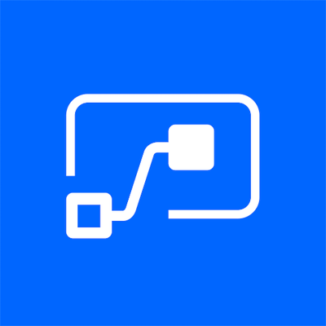
About Ajiboye Kolawole
Value Explorer/Office365 Admin.
linkedin.com/in/ajiboye-kolawole-b892b845
Facebook.com/Ajiboye Kolawole
Twitter.com/Kollyjose
Microsoft Fundamentals

Slide 3
Introduction to Power Automate
What is Microsoft flow/Power Automate
What can we do with Microsoft Power Automate
Features of Power Automate
A Tour to power Automate

Slide 4
Introduction to Power Automate
Microsoft rebrands Microsoft FLOW as “Power Automate” ,
Which is versertile Automation Platform.

Slide 5
What we can do with Power Automate
Instantly responding to high-Priority notifications or emails
Capture, track, and follow up with new sales leads.
Copy all attachment email to your OneDrive
Automate Approval workflow

Slide 6
TYPES OF FLOWS
Automated flow | Create a flow that performs one or more tasks automatically after it's triggered by an event.
Button flows | Run repetitive tasks from anyplace, at any time, via your mobile device.
Scheduled flows | Create a flow that performs one or more tasks on a schedule.
Business process flows | Define a set of steps for people to follow to take them to a desired outcome.

Slide 7
Why Automation?
Increase Productivity
Eliminate Inconcistency
Focus on Business Critical Issues

Slide 8
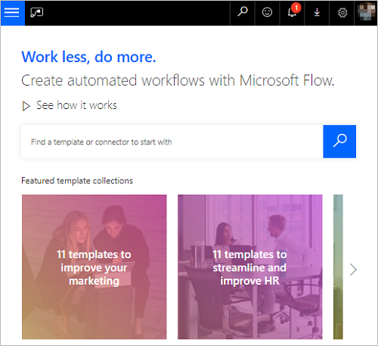
Easily search for templates and services

Slide 9

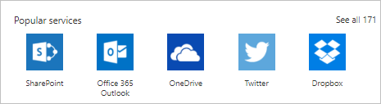
Choose from the most popular services.

Slide 10
Real World used cases
Within power Platform
PowerBI
PowerApps
Power Virtual Agent

Slide 11
Triggers
Set the flow in Motion
An event
A botton
Schedule
ACTIONS
What you want to happen a trigger is invoked

Slide 12
What is a template
A pre-built flow that performs one or more tasks automatically after it is triggered by an event
Can be modified to your specific needs

Slide 13
Using Templates in Power Automate
Templates
Connectors

Slide 14
DEMO
Getting Started with Power Automate

Slide 15

Questions

Slide 16

Thank you

